Slide 1







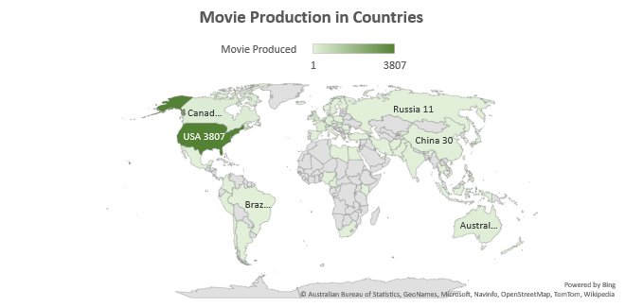
MOVIES IN 100 YEARS
The Movie Industry have transitioned immensely serving quality contents over the centuries to homes . This is an overview of Movie Ratings within 100 years (1916 – 2016). Data source: IMDb movies (Internet Movie Database) an online database of information related to films, videos and streaming contents online.
Movie Duration
Average Duration of Movie play is approximately 107mins
Movies Production
A number of 5043 movies were produced between 1941 – 2016 across 62 Countries
Money Spent
Over $180 Billions spent on Movie Production.
Reviews
A total of 699990 reviews were made between this period
////////////////////////
MOVIES DURATION & SALES RECORDS
INFORMATION
More than $20 billion profit was generated from sales of movie
In the advert of the new century, More Money was spent in Making of Movies.
2012 recorded the highest revenue generated from sales of Movies.
150+ Movies spanned beyond 3 hours which is less than 10% of the total number of Movie.
The Avengers ranked top in all time movie sales with over $1.2 billion in generated from sales.
Sales Records
////////////////////////
$20billion
Over
Profits
Movies Sales
////////////////////////
A total of 5043 Movies were produced between 1916 – 2016 across 62 countries. More Sales are made in 2012 with USA raking high in sales and production..
PRODUCTION
& SALES
From the Data, It shows that More movies are produced in America and Europe also this accounts for the High sales coming from these Regions.
More so, Movie Director Steven Spielberg , ranks high in Number of movies produced and Profits made.
Content Rating R is produced more and also has more sales
Learn More

